Slide 1
Michigan Teen Smoking and Drug Use Survey
Sample Design
Team Cochran
April 16, 2025

Slide 2
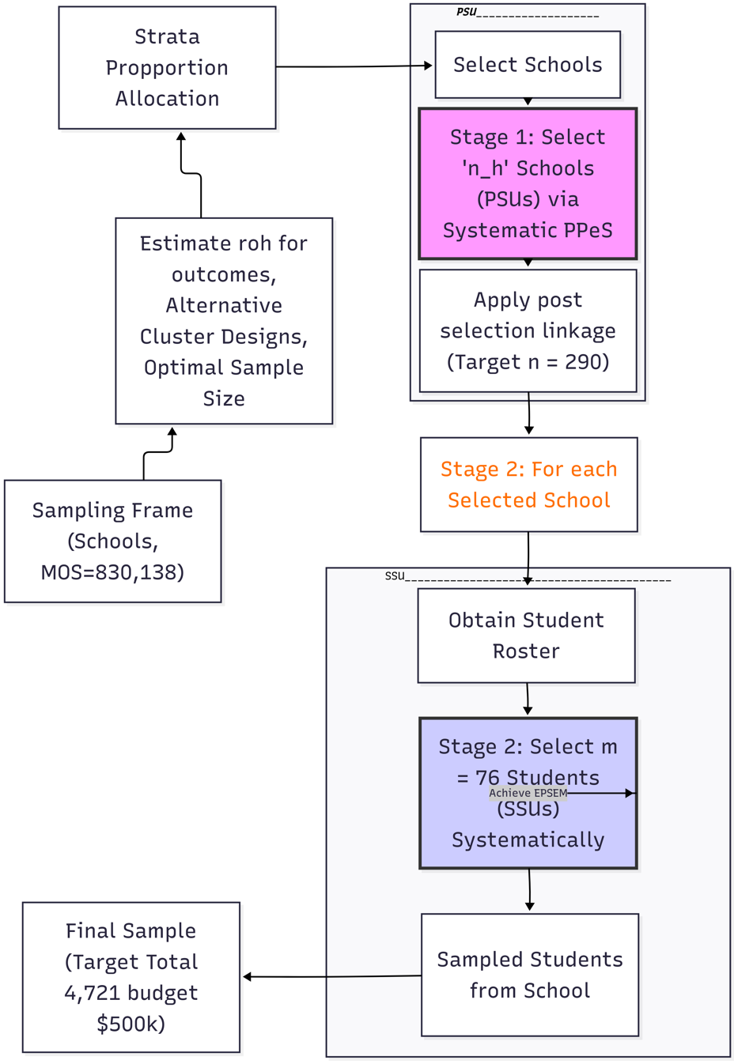
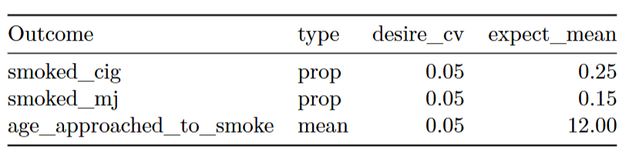
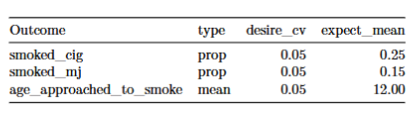
Project Overview & Objectives
Key Variables and Precision Requirement:
Sampling Frame: 2024 MDE list of (non)public schools with head counts. Total Students (N) ≈ 830,138.
Frame Limitations: Excludes homeschooled students and dropouts. Assumes provided list is exhaustive.

Slide 3
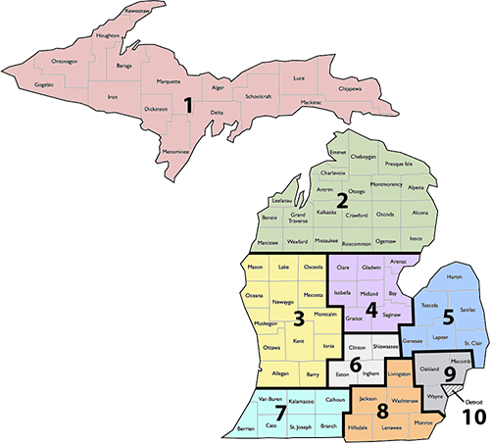
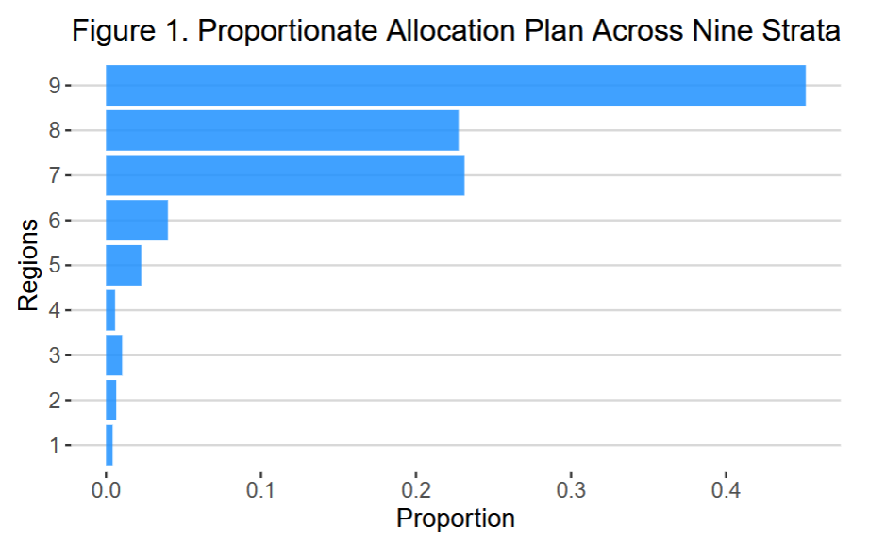
Stratification &
Allocation
Nine Education regions
Increase precision, separate regional estimates

Slide 4
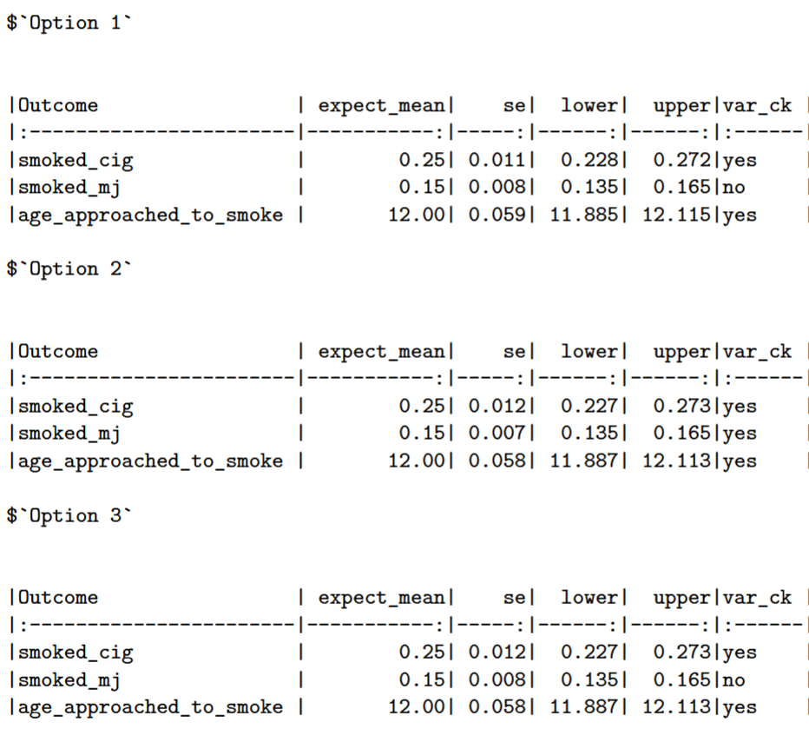
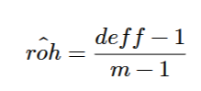
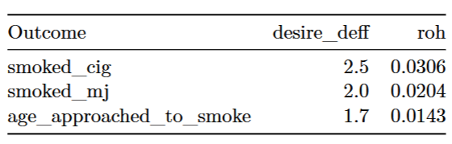
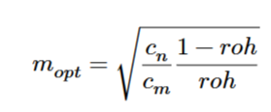
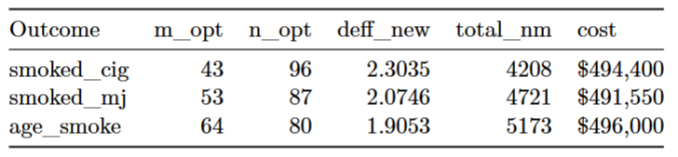
Determining Sample Size Components (n & m))
Estimating roh:
Budget & Costs: 𝑐𝑛= $3, 000, 𝑐𝑚= $50, total 𝐶 = $500, 000

Slide 5
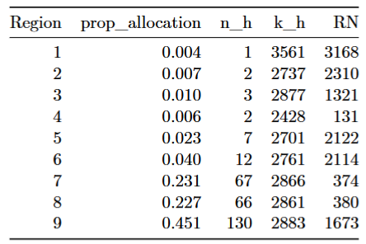
Stage 1, School Selection (PPeS)
Non-response Adjustment
n = 290 (n_opt = 87)
m = 76 (m_opt = 53)
Cluster_allocation, n_h
Selection Method
Systematic PPeS, within stratum
Implicit stratification
Sorted by student size
School allocation
Sampling Interval
Calculate sample interval
Linking
Post selection linkage

Slide 6
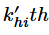
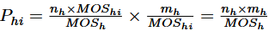
Stage 2, Student Selection & Linking
Goal
Maintain EPSEM across strata
Selection Technique
Calculate random start, 1 to
Select student at random start, every
Minimum MOS check, if fails link w/ next school until MOS is achieved
Student Selection
Systematic random sampling from student roster within selected cluster of schools
Probability of student inclusion
Target students, 4, 721

Slide 7
Variance Estimation
Method
Paired Difference Replication Method (Taylor Series Linearization compatible). Accounts for stratification and clustering.
Variance Strata (Pseudo-Strata)
Formed by sequentially pairing the a_select = 290 selected schools based on selection order within original strata. Total V = 145 variance/pseudo strata.
Variance Formula Concept
Var(estimate) = Sum[ (Estimate_PairMember1 - Estimate_PairMember2)^2 ] summed over all V=145 pairs (with appropriate scaling).
Degrees of Freedom
df = Number of Pairs = 145.
Subclass Estimation (e.g., 20% low-income)
Use same variance estimation method and df. Expected ~11 subclass members per school appears adequate.

Slide 8
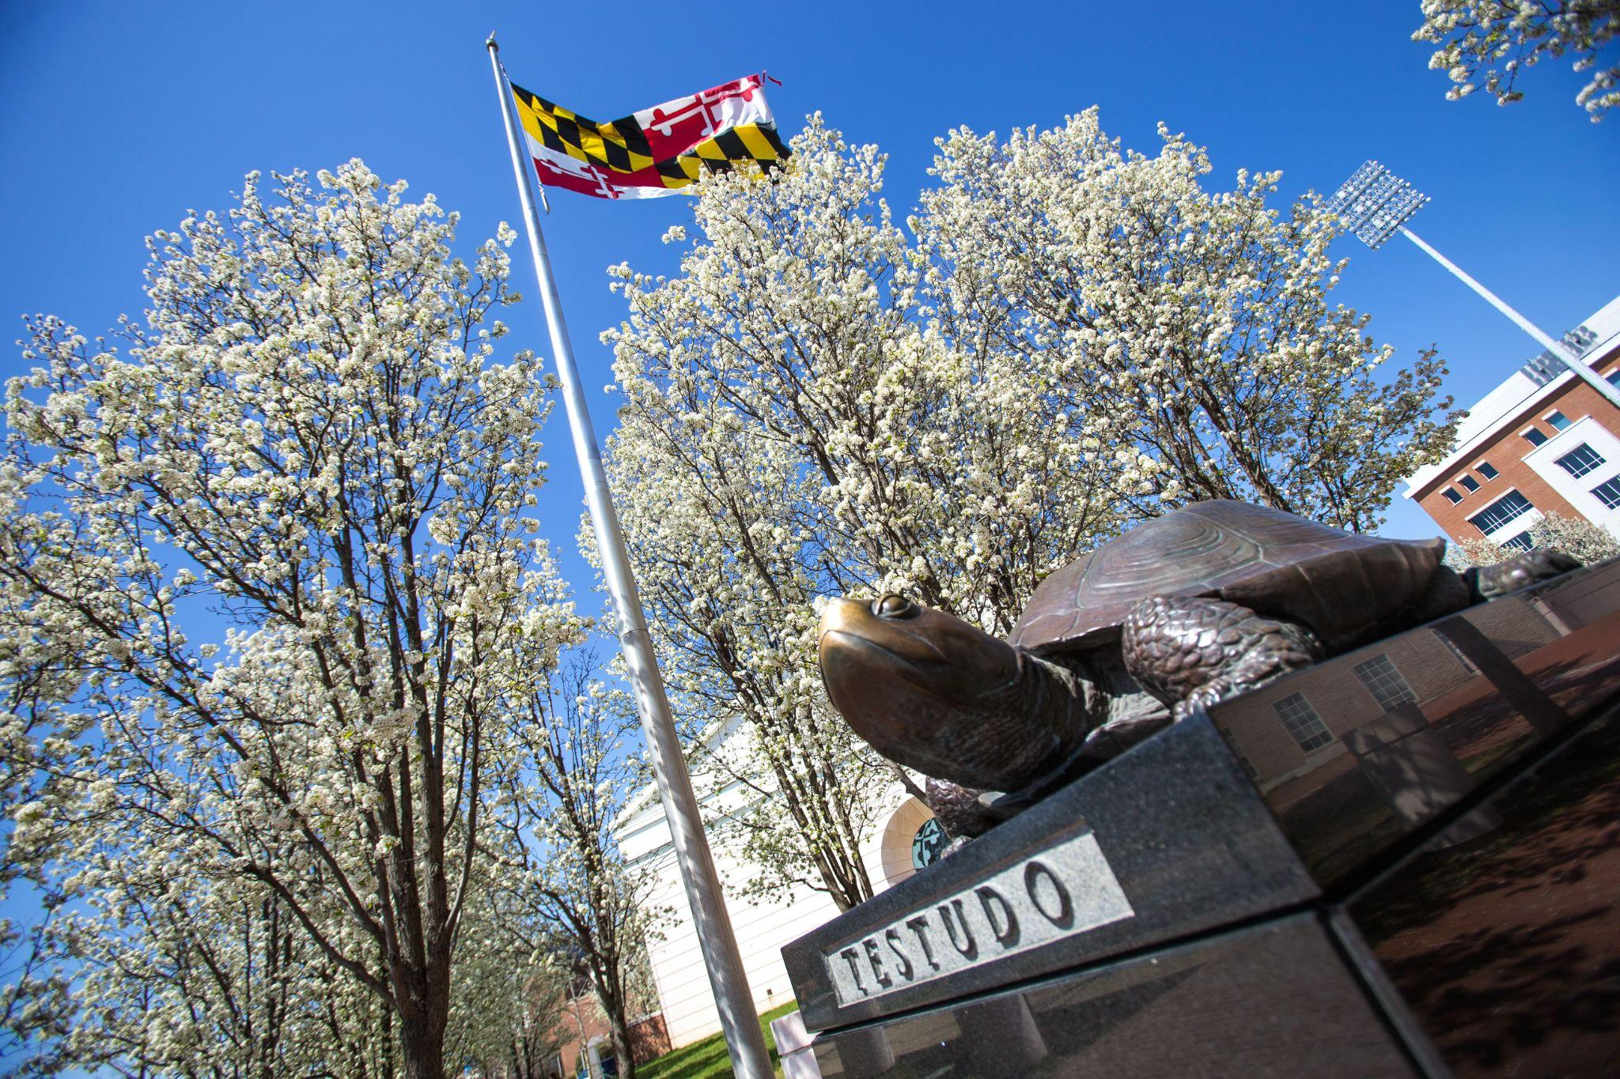
Questions?

